Slide 1
OpenPosture
By: Ally Ryan, Michael Nweke, Parisha Rathod
UMKC School of Engineering - Data Science M.S.

Slide 2
Introduction
OpenPosture aims to improve the posture of seated working professionals and busy students to mitigate back, neck, and hip pain caused by poor seated posture and/or long-term and frequent sitting. In turn, it aims to increase productivity and overall well-being. This project utilizes OpenCV to detect key points on the body and requires two main dependencies to run: Keras and TensorFlow. OpenPosture was inspired by an MIT developed initiative titled “Seated-Posture-Recognition.” “Seated-Posture-Recognition” utilized Keras and TensorFlow to run an OpenCV model that detected the position of an individual’s back as leaning forward, reclining, or straight, the position of an individual’s hands as crossed versus uncrossed, and the position of the person's feet as kneeling versus not kneeling. Utilizing a similar OpenCV model enabled by Keras and TensorFlow, OpenPosture aims to detect back position, neck position, hand position, leg position, and if the individual’s feet are on the floor versus the ground. OpenPosture further aims to propose workouts for each postural element.

Slide 3
Related Works
PostureScreen Mobile is a posture analysis and correction app developed by Dr. Joseph D. Busch, a chiropractor, and is available for both iOS and Android devices. The app utilizes the device's camera to assess a person's posture and utilizes advanced computer vision technology to provide real-time feedback and recommendations based on the analysis. It is widely used by healthcare professionals, including chiropractors, physical therapists, and fitness trainers, as well as individuals looking to improve their posture and overall spinal health. PostureScreen Mobile further enables users to track their progress over time, drawing from insights gleaned from behavioral psychology to promote lasting habit changes.
Upright Go is an innovative app that pairs with a small wearable device that attaches to the user's upper back. Using advanced sensor technology, Upright Go detects and tracks the user's posture throughout the day. Drawing on principles from ergonomics and physical therapy, the app provides real-time feedback to help users maintain proper posture and avoid slouching and employs gentle vibrations to remind users to adjust their posture when needed and foster long-term habit changes. Furthermore, "Upright Go" integrates with other health and fitness apps, offering a comprehensive approach to overall well-being.

Slide 4
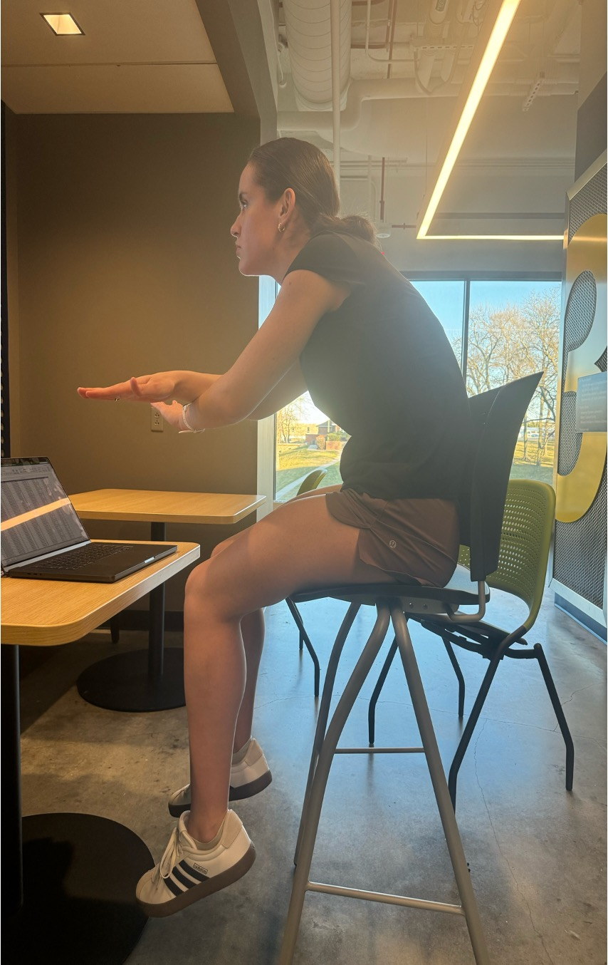
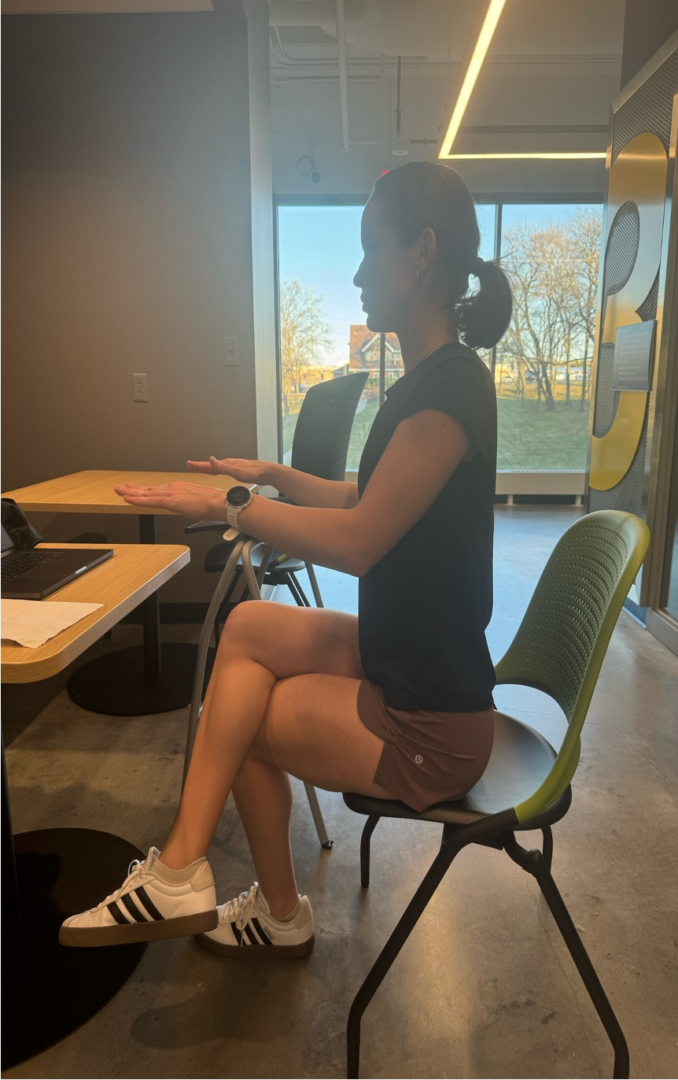
Data

Slide 5
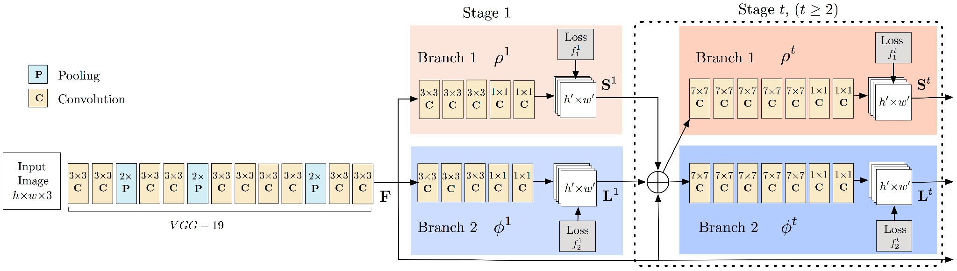
Data Science Methodology

Slide 6
Methodology: Static Image
Dataset Preparation:
A curated dataset of 144 diverse seated posture images underpins model training, focusing on critical body parts like the back, hands, neck, and feet for accurate posture recognition.
Data Cleaning and Preprocessing:
Images are normalized, resized for uniformity, and augmented to enhance the model's generalization across various seating scenarios, using a Keras model with a VGG-like architecture for efficient preprocessing and analysis.
Posture Analysis:
The system precisely identifies key posture points and assesses posture alignment, leveraging integrated preprocessing to prepare images for optimal analysis. This process pinpoints specific areas needing improvement.
Personalized Feedback:
Based on posture analysis, personalized correction recommendations are generated and delivered through a Vue.js-designed user interface, powered by Firebase, offering users an intuitive and seamless experience in improving their posture.

Slide 7
Methodology: Real-time Video
Setup and Configuration:
The system is meticulously configured with the appropriate hardware and software to capture and analyze real-time posture data effectively. Key to this setup is the strategic positioning of cameras to ensure comprehensive posture capture.
Posture Detection Algorithm:
Real-time video feeds are processed using advanced machine learning models, which perform keypoint detection and posture assessment. Preprocessing techniques, including noise reduction, are integrated to optimize the video input for the detection model, ensuring accurate posture analysis against established metrics.
Feedback Mechanism:
Based on the analysis, an immediate feedback mechanism provides visual cues directly to the user. This responsive system suggests posture adjustments, prompts breaks, or offers specific exercises designed to mitigate any detected posture issues, fostering an interactive and beneficial user experience.

Slide 8
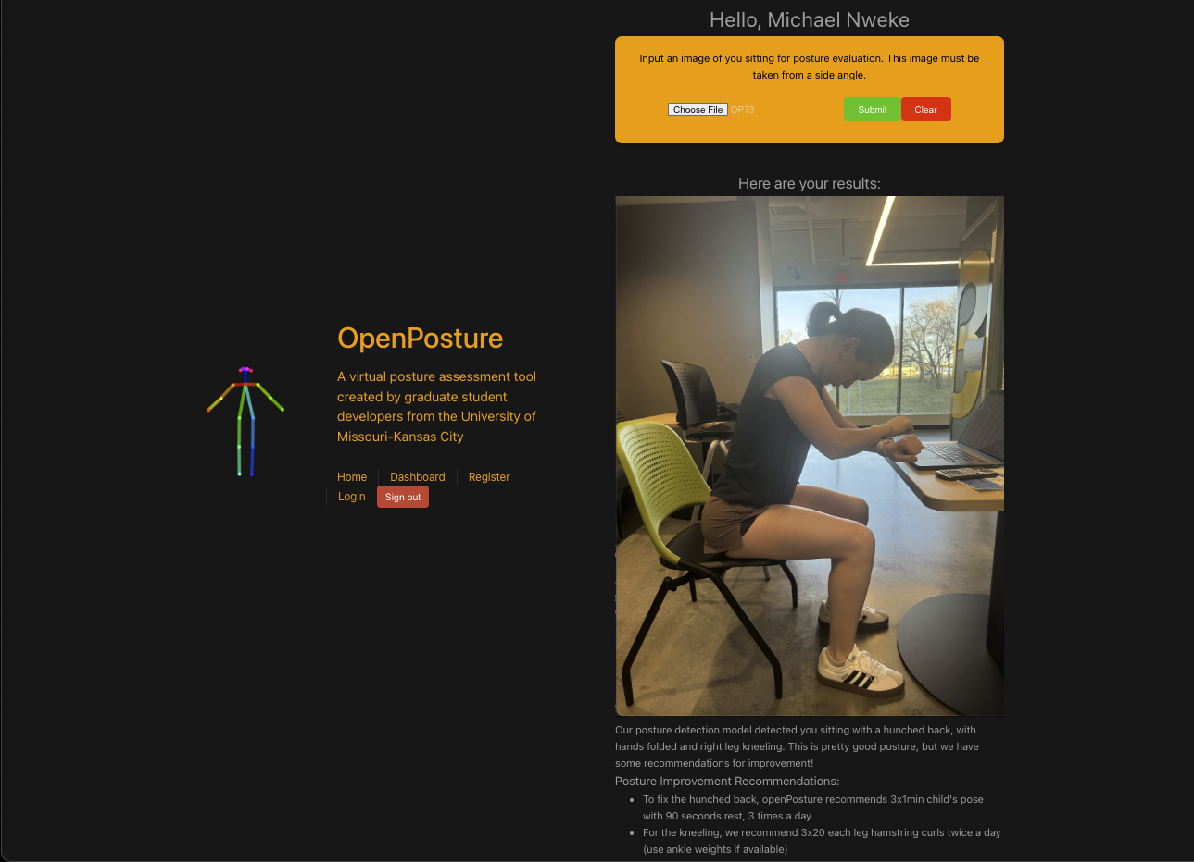
Results Image

Slide 9
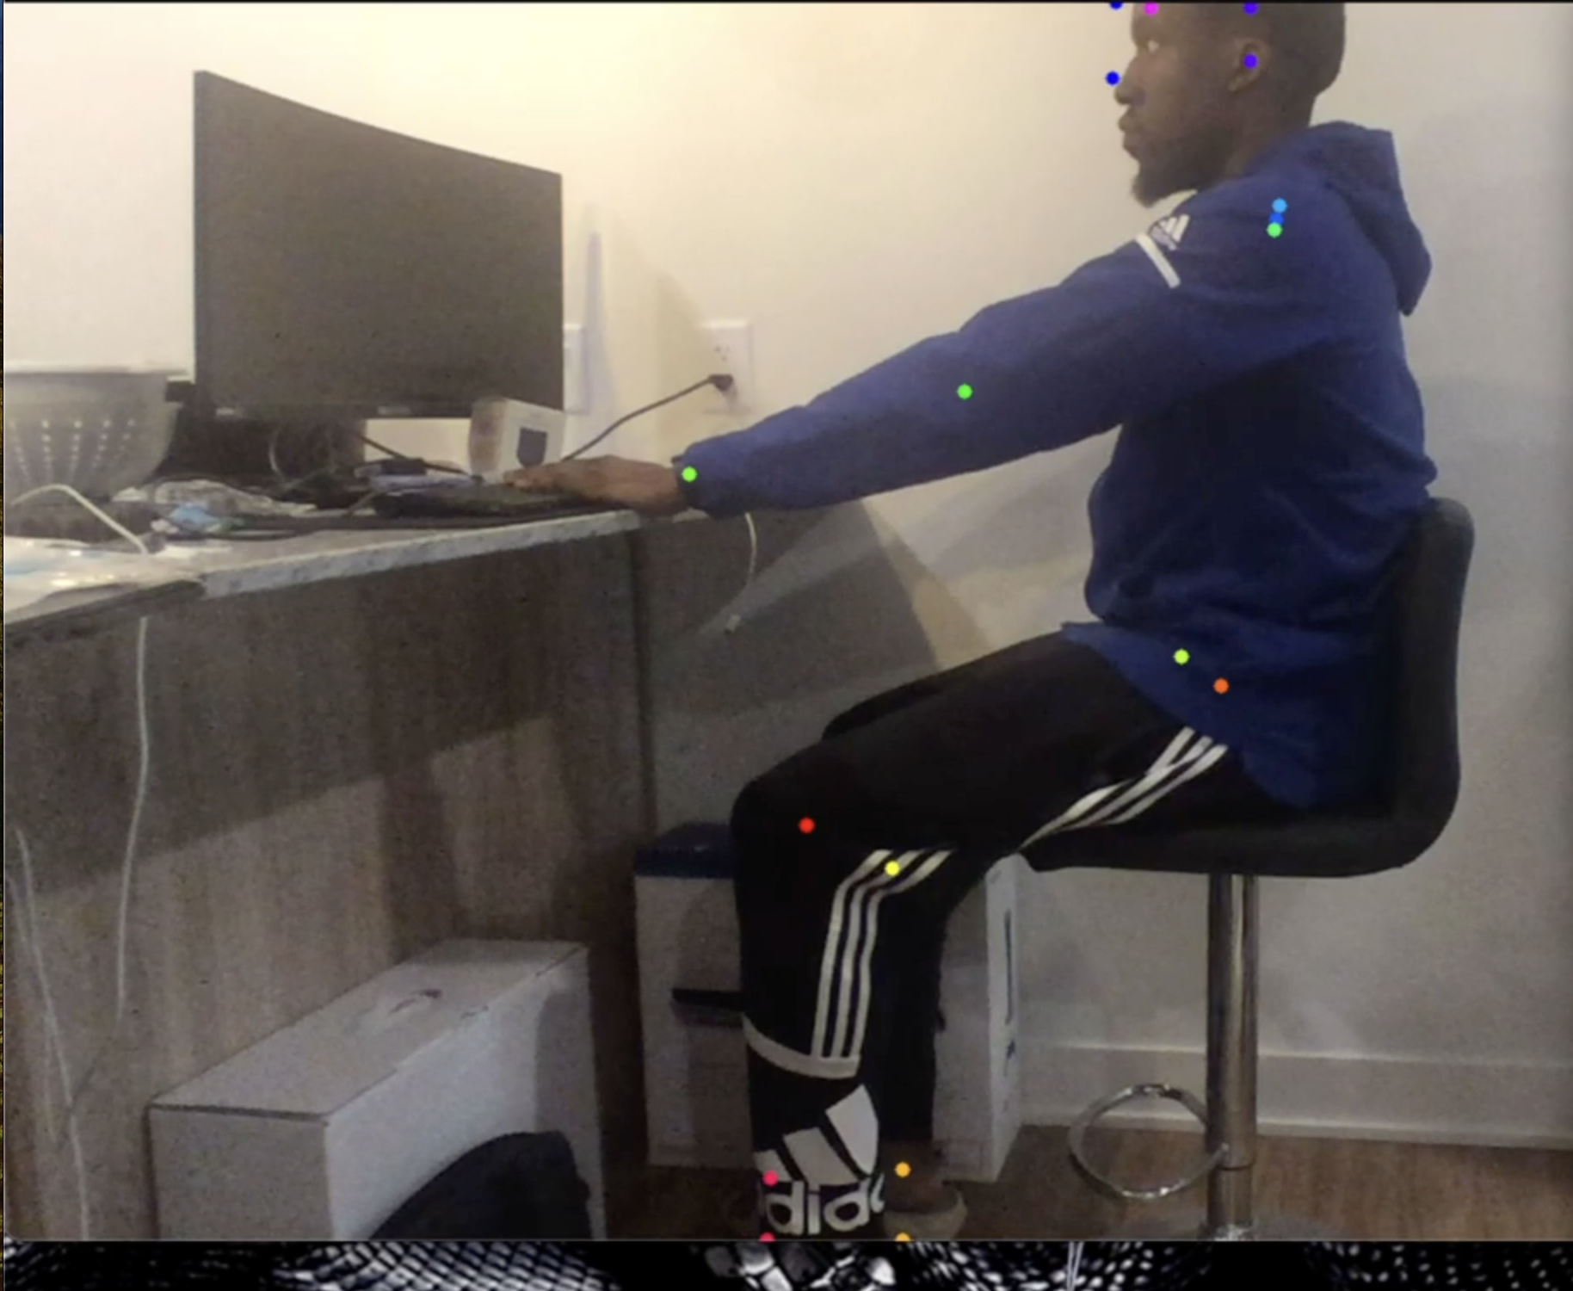
Results Real time

Slide 10
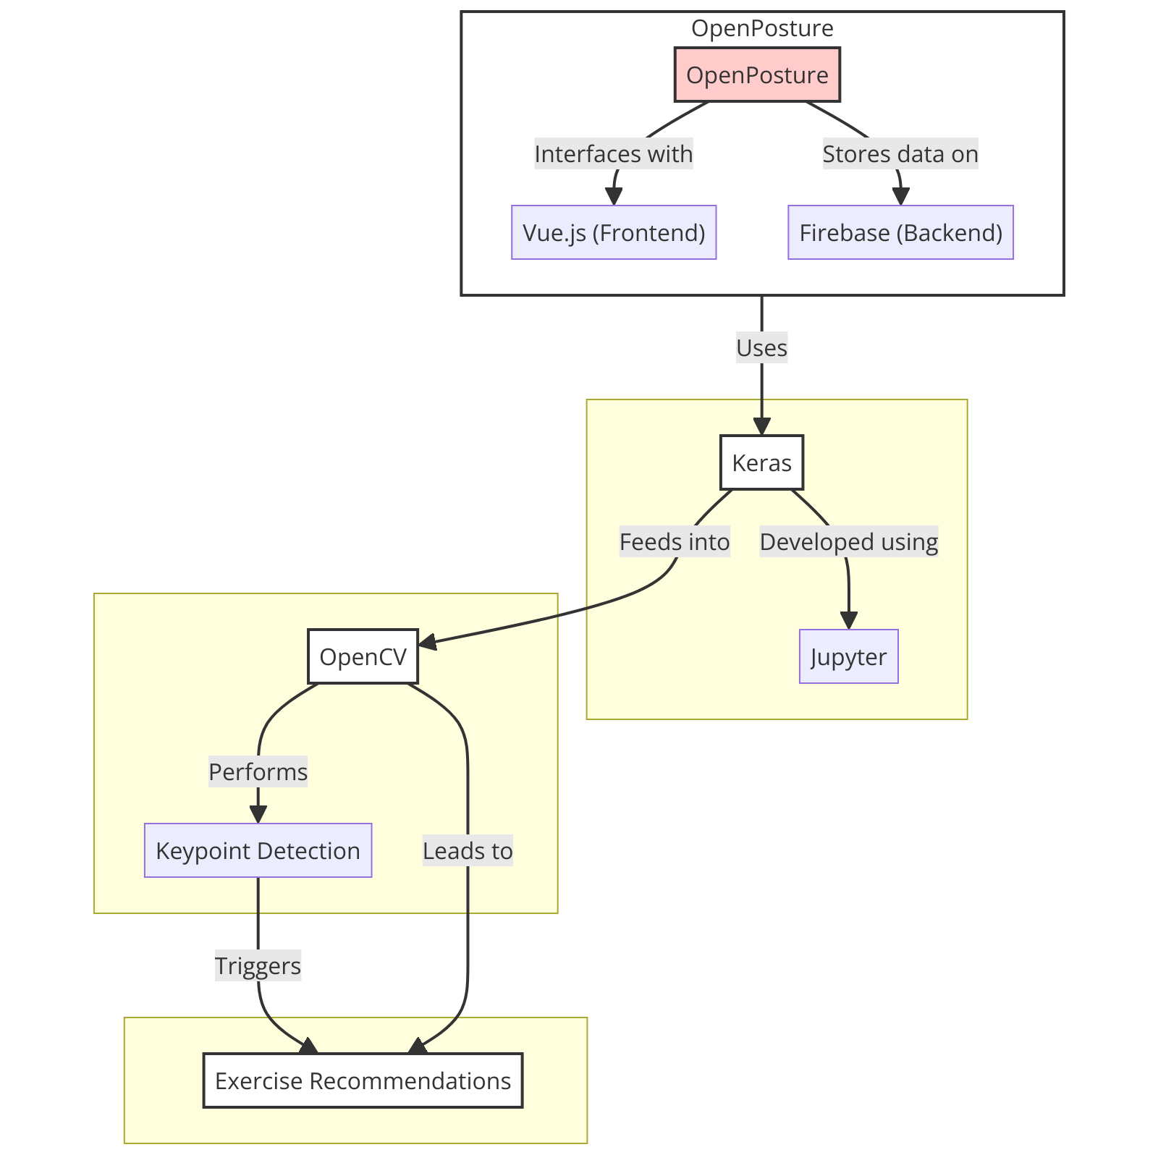
Model Diagram

Slide 11
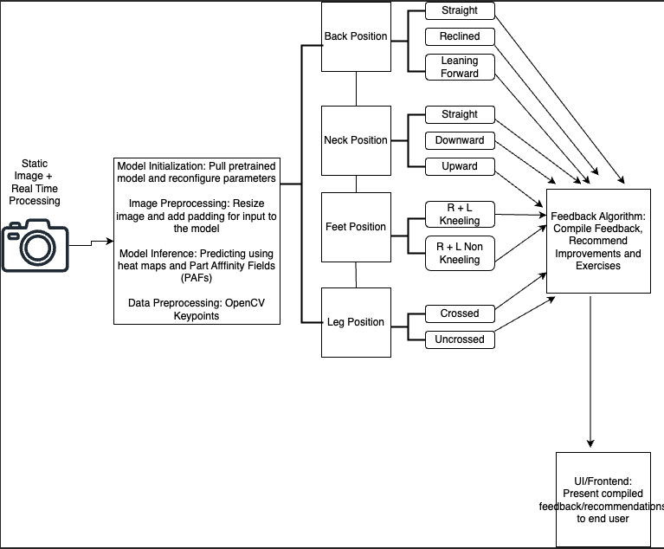
Conceptual Diagram

Slide 12
Conclusion
OpenPosture successfully detects back, neck, feet, leg, and kneeling posture through images and real time. It proposes workouts to help mitigate back and neck pain for each posture and increase productivity. The OpenPosture app will serve as a valuable resource to students across universities and Big4 Accounting Firms through a monthly subscription plan.

Slide 13
Future Works
Object Detection: Integrating real-time object detection capabilities within the OpenPosture system would enhance its ability to recognize and provide insights on specific objects in the user's environment. Such insights might include lowering the chair, raising the desk, or moving the keyboard forward to enable better posture and mitigate pain.
Single-Device Use: Optimizing OpenPosture for single-device use could eliminate logistical challenges for users with a single device and streamline the user experience by removing the need for additional hardware.
Camera Positioning Guidance: Incorporating visual aids, instructions, or alarms/audio cues within the app to assist users in positioning the camera effectively would improve posture assessment accuracy.
Customization: Offering customization options within the app regarding workout capabilities, known medical diagnoses (e.g., scoliosis), age, or physical characteristics (e.g., amputated body part) would cater to diverse user preferences and needs.
Subscription Management: Establishing and allowing options for different subscription plans would allow users to choose the version of the app that best suits their needs and financial interests.

Slide 14
References
https://github.com/nvinayvarma189/Sitting-Posture-Recognition
https://store.uprightpose.com/products/upright-go2

